Slide 1
User’s Profile
Name
Gender
Age
Weight
kgs
Height
cm
Create Profile

Slide 2
User’s Profile
Name
Gender
Male
Female
Female (Pregnant)
Female (Breastfeeding)
Age
Weight
kg
Height
cm
Create Profile

Slide 3
User’s Profile
Name
Gender
Age
2 – 3 4 - 8
9 – 11 12 – 13
14 – 18 19 – 50
51 – 70 70+
Weight
kg
Height
cm
Create Profile

Slide 4
User’s Profile
Name
Gender
Age
Weight
kgs
lbs
kgs
Height
cm
Create Profile

Slide 5
User’s Profile
Name
Gender
Age
Weight
kgs
Height
cm
cm
inches
Create Profile

Slide 6



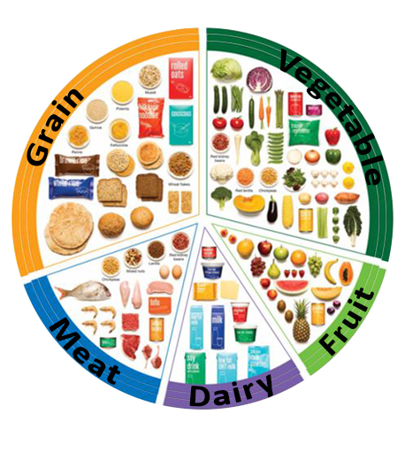
<< 27 OCT 2015 >>
65%
Grain
85%
Meat
Dairy
55%
70%
Fruit
History
40%
Vegetable
Select a Food Group

Slide 7
<< 27 OCT 2015 >>
65%
Grain
85%
Meat
Dairy
55%
70%
Fruit
History
40%
Vegetable
Select a Food Group
# of Serve (Grain)
?
1
+
Breakfast
-
Done
Cancel

Slide 8
<< 27 OCT 2015 >>
65%
Grain
85%
Meat
Dairy
55%
70%
Fruit
History
40%
Vegetable
Select a Food Group
# of Serve (Meat)
?
3
+
Breakfast
-
Done
Cancel

Slide 9
<< 27 OCT 2015 >>
65%
Grain
85%
Meat
Dairy
55%
70%
Fruit
History
40%
Vegetable
Select a Food Group
# of Serve (Dairy)
?
1
+
Breakfast
-
Done
Cancel

Slide 10
<< 27 OCT 2015 >>
65%
Grain
85%
Meat
Dairy
55%
70%
Fruit
History
40%
Vegetable
Select a Food Group
# of Serve (Fruit)
?
1
+
Breakfast
-
Done
Cancel

Slide 11
<< 27 OCT 2015 >>
65%
Grain
85%
Meat
Dairy
55%
70%
Fruit
History
40%
Vegetable
Select a Food Group
# of Serve (Vegetable)
?
3
+
Breakfast
-
Done
Cancel

Slide 12
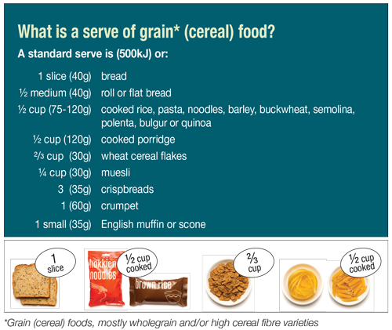
Size a Serve - Grains
Back

Slide 13
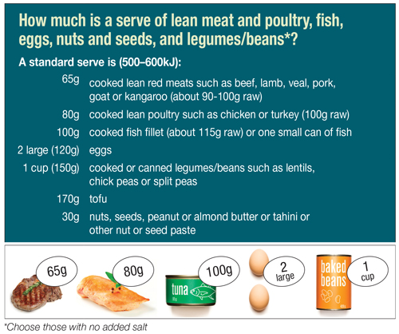
Size a Serve - Meats
Back

Slide 14
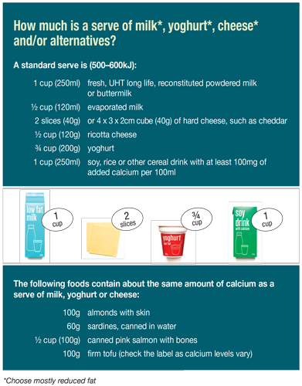
Size a Serve - Dairy
Back

Slide 15
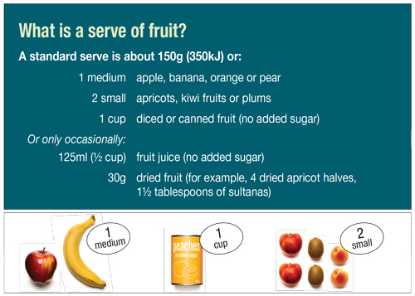
Size a Serve - Fruits
Back

Slide 16
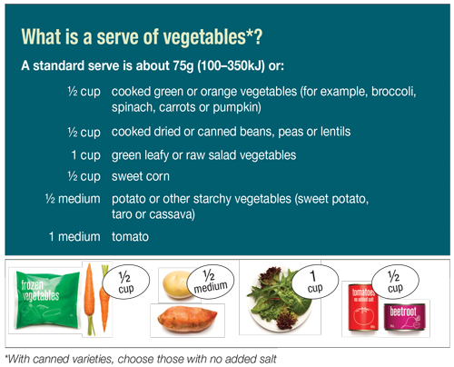
Size a Serve - Vegetable
Back

Slide 17



Daily Report
<< 27 Oct 2015 >>
60%
(6) Grain
(3) Meat
85%
55%
(2.5) Dairy
70%
(2) Fruit
50%
(6) Vegetable
Meal | Group | Serve
Breakfast | Grain | 1 | Edit
 | Dairy | 2 | Edit
Lunch | Grain | 2 | Edit
 | Vegetable | 3 | Edit
 | Meat | 3 | Edit
Dinner | Meat | 1 | Edit
 | Grain | 1 | Edit
Extras | Fruit | 1 | Edit

Slide 18
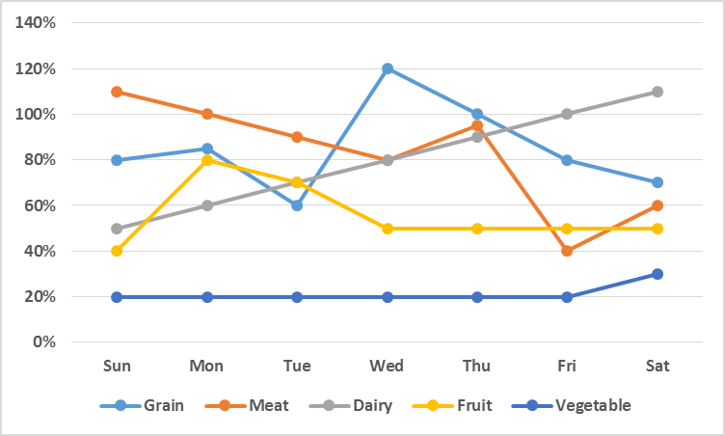
Weekly Report
<< 25-31 Oct 2015 >>
Group | Total | Average
Grain | 14 | 2
Meat | 21 | 3
Dairy | 14 | 2
Fruit | 7 | 1
Vegetable | 7 | 1

Slide 19
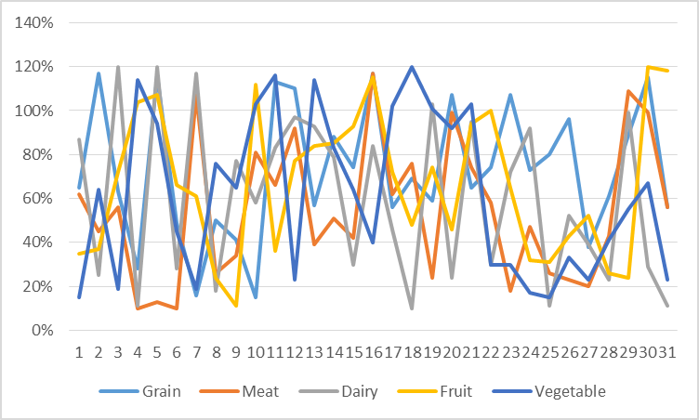
Monthly Report
<< Oct 2015 >>
Group | Total | Average
Grain | 62 | 2
Meat | 93 | 3
Dairy | 62 | 2
Fruit | 31 | 1
Vegetable | 31 | 1

Slide 20
Daily Report
<< 27 Oct 2015 >>
60%
Grain (6)
# of Serve (Vegetable)
85%
Meat (3)
?
2
+
Lunch
55%
Dairy (2.5)
-
Fruit (2)
70%
50%
Vegetable (6)
Done
Cancel
Meal | Group | Serve
Breakfast | Grain | 1 | Edit
 | Dairy | 2 | Edit
Lunch | Grain | 2 | Edit
 | Vegetable | 3 | Edit
 | Meat | 3 | Edit
Dinner | Meat | 1 | Edit
 | Grain | 1 | Edit
Extras | Fruit | 1 | Edit

Slide 21
Size a Serve - Vegetable
Back

Slide 22
Daily Report
<< 27 Oct 2015 >>
60%
(6) Grain
(3) Meat
85%
55%
(2.5) Dairy
70%
(2) Fruit
50%
(6) Vegetable
Meal | Group | Serve
Breakfast | Grain | 1 | Edit
 | Dairy | 2 | Edit
Lunch | Grain | 2 | Edit
 | Vegetable | 2 | Edit
 | Meat | 3 | Edit
Dinner | Meat | 1 | Edit
 | Grain | 1 | Edit
Extras | Fruit | 1 | Edit

Slide 23
Daily Report
<< 27 Oct 2015 >>
60%
(6) Grain
(3) Meat
85%
55%
(2.5) Dairy
70%
(2) Fruit
50%
(6) Vegetable
Meal | Group | Serve
Breakfast | Grain | 1 | Edit
 | Dairy | 2 | Edit
Lunch | Grain | 2 | Edit
 | Vegetable | 3 | Edit
 | Meat | 3 | Edit
Dinner | Meat | 1 | Edit
 | Grain | 1 | Edit

Slide 24
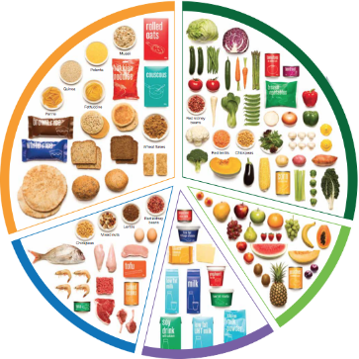

Instruction
Click on the pie chart to select a food group
Enter serving amount
Select either breakfast/ lunch/dinner/extras
Click “Done” when finish
Not sure about the serving size, click “?”
Click “History” to see detailed information, edit options, and view reports
Click arrows << or >> to view status report on other days
Click on a food group
Enter serving amount
Select either breakfast/ lunch/dinner/extras
Click “Done” when finish
Not sure about the serving size, click “?”
Click “Detailed Summary” for more information, editing, and report
Click arrows << or >> to view status report on other days
Back

Slide 25
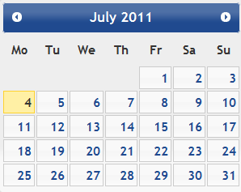
Daily Report
<< 27 Oct 2015 >>
60%
Grain (6)
85%
Meat (3)
55%
Dairy (2.5)
Fruit (2)
70%
50%
Vegetable (6)
Meal | Group | Serve
Breakfast | Grain | 1 | Edit
 | Dairy | 2 | Edit
Lunch | Grain | 2 | Edit
 | Vegetable | 3 | Edit
 | Meat | 3 | Edit
Dinner | Meat | 1 | Edit
 | Grain | 1 | Edit
Extras | Fruit | 1 | Edit

Slide 26
Weekly Report
<< 25-31 Oct 2015 >>
Group | Total | Average
Grain | 14 | 2
Meat | 21 | 3
Dairy | 14 | 2
Fruit | 7 | 1
Vegetable | 7 | 1

Slide 27
Monthly Report
<< Oct 2015 >>
Group | Total | Average
Grain | 62 | 2
Meat | 93 | 3
Dairy | 62 | 2
Fruit | 31 | 1
Vegetable | 31 | 1

Slide 28
Instruction
Click on the pie chart to select a food group
Enter serving amount
Select either breakfast/ lunch/dinner/extras
Click “Done” when finish
Not sure about the serving size, click “?”
Click “History” to see detailed information, edit options, and view reports
Click arrows << or >> to view status report on other days
Click on a food group
Enter serving amount
Select either breakfast/ lunch/dinner/extras
Click “Done” when finish
Not sure about the serving size, click “?”
Click “Detailed Summary” for more information, editing, and report
Click arrows << or >> to view status report on other days
Proceed

